Slide 1

Time Management
Work Smarter, Not Harder — practical strategies for students and professionals to plan, prioritise, and execute with clarity.
Presented by: Name · Date: Today

Slide 2

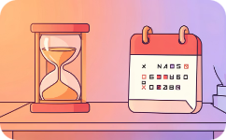

Introduction: What Is Time Management?
Meaning
Time as a Limited Resource
Need in Daily Life
Deliberate planning and allocation of time to tasks to achieve goals efficiently.
Improves focus, reduces chaos, and creates predictability for study, work and rest.
Every day has finite hours — prioritisation turns limited time into meaningful progress.

Slide 3
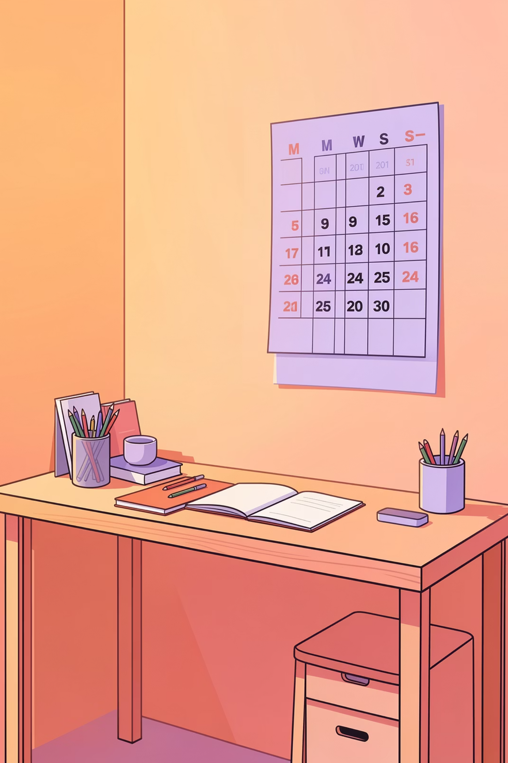
Why Time Management Matters
Effective time management transforms intentions into results. It increases productivity, lowers stress, and helps you meet deadlines while preserving personal time. For students it improves learning outcomes; for professionals it boosts career momentum and reliability.
Increases Productivity
Reduces Stress
Better Work–Life Balance
Predictable schedules reduce last-minute pressure and anxiety.
Clear plans reduce decision fatigue and speed execution.
Intentional boundaries protect rest and relationships.

Slide 4


Common Time Wasters
Social Media
Endless feeds eat fragmented minutes into hours — schedule specific checking windows.
Procrastination
Delay creates urgency and lowers quality; tackle initiation with small wins.
Multitasking
Switching costs reduce efficiency — focus on one high-value task at a time.
No Planning
Working reactively wastes time; plan daily and weekly priorities in advance.

Slide 5
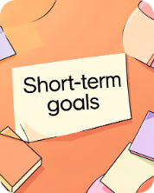
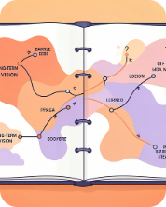
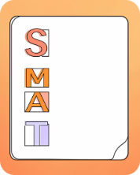
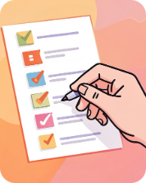
Goal Setting: Roadmap to Progress
Clear goals focus your time. Use a layered approach: short-term tasks that ladder into long-term objectives. Translate ambitions into measurable steps so daily actions compound into meaningful outcomes.
Short-term Goals
Long-term Goals
SMART Goals
Task Prioritisation
Daily and weekly targets that are actionable and reviewable.
Six-month to multi-year outcomes that guide prioritisation.
Specific, Measurable, Achievable, Relevant, Time-bound — the backbone of effective planning.
Rank tasks by impact and deadline; invest time in high-value activities first.

Slide 6

Daily Planning: Practical Habits
To‑Do List
Keep a concise daily list (3–5 priority tasks). Review and adjust at day end.
Time Blocking
Reserve focused blocks for deep work, breaks, and administrative tasks to reduce context switching.
Set Deadlines
Assign realistic end times to each task to create momentum and measurable progress.
Morning Planning Habit
Spend 10 minutes each morning to align daily actions with weekly goals and energy levels.

Slide 7
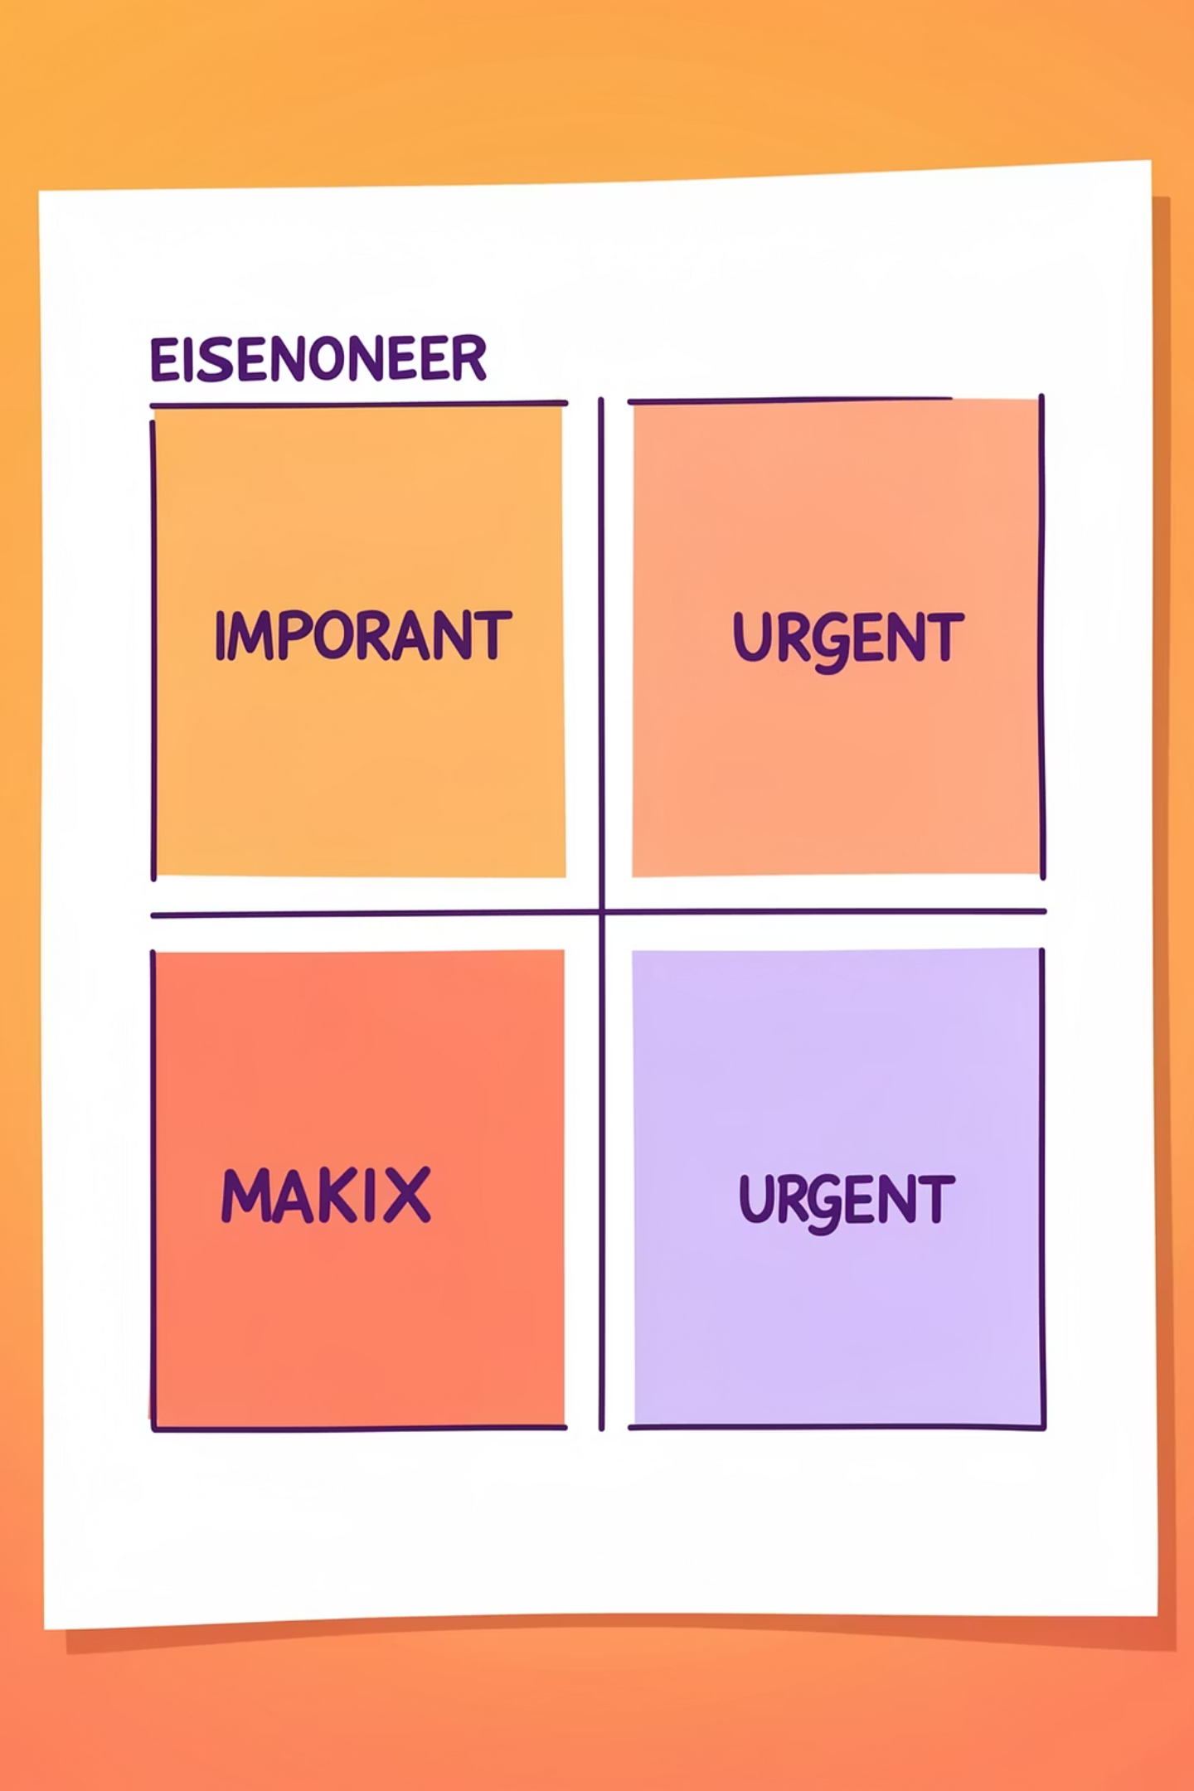
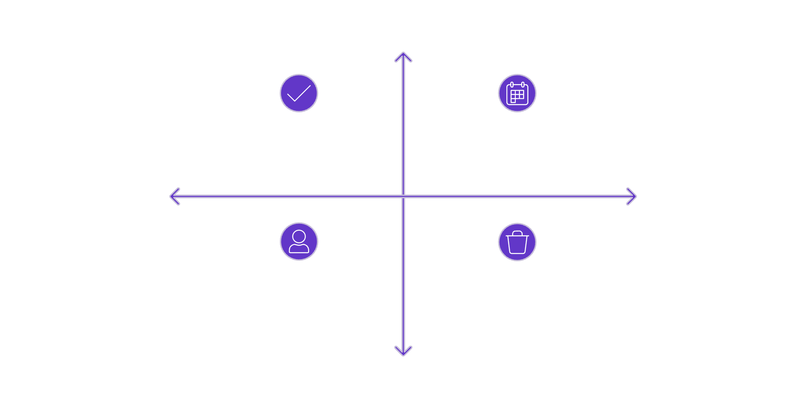
Prioritisation Methods
Important
Do - Urgent & Important
Schedule - Important, Not Urgent
Not Urgent
Urgent
Delegate - Urgent, Not Important
Delete - Not Urgent, Not Important
Not Important
Use the Eisenhower Matrix to separate urgent tasks from important ones. Focus on high-value tasks (Important) and schedule or delegate lower-impact work. This preserves time for long-term growth while handling short-term needs.

Slide 8
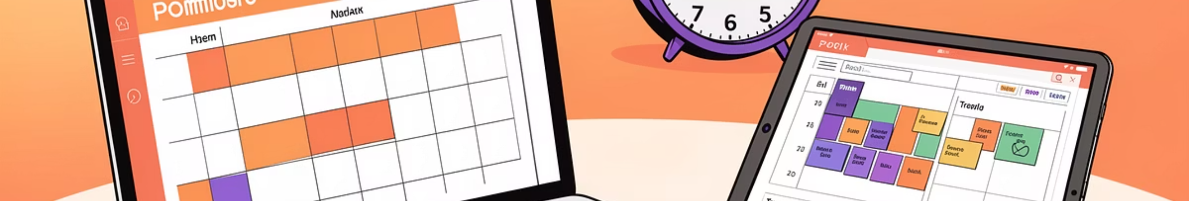
Tools & Techniques
Google Calendar
Trello / Notion
Time blocking and reminders synchronised across devices for reliable scheduling.
Visual boards and databases to track tasks, projects and deadlines collaboratively.
Pomodoro Technique
Reminders & Automations
Work in 25–50 minute focused intervals with short breaks to sustain concentration.
Use alarms, recurring tasks and simple automations to remove memory load and keep rhythm.

Slide 9

Tips to Overcome Procrastination
Break Tasks into Steps
Remove Distractions
Start with Hardest Task
Small, well-defined actions reduce inertia and make starting straightforward.
Silence notifications, create a focused environment, and use website blockers when needed.
Tackle the most challenging item when energy is highest — it improves momentum for the rest of the day.
Self‑Discipline & Rewards
Use accountability, public commitments, and small rewards to reinforce productive habits.

Slide 10

Thank You
Thank you for your time. Implement one change this week — pick a single habit from this session and apply it for seven days. You’ll notice improved clarity and steady momentum.
Any questions? Contact: you@example.com

